Slide 1
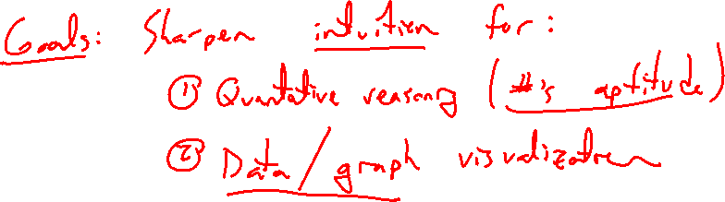
Chapter 1 Equations and Graphs
Introduction
Notes:
Sharpen intuition for quantitative reasoning / data visualization

Slide 2
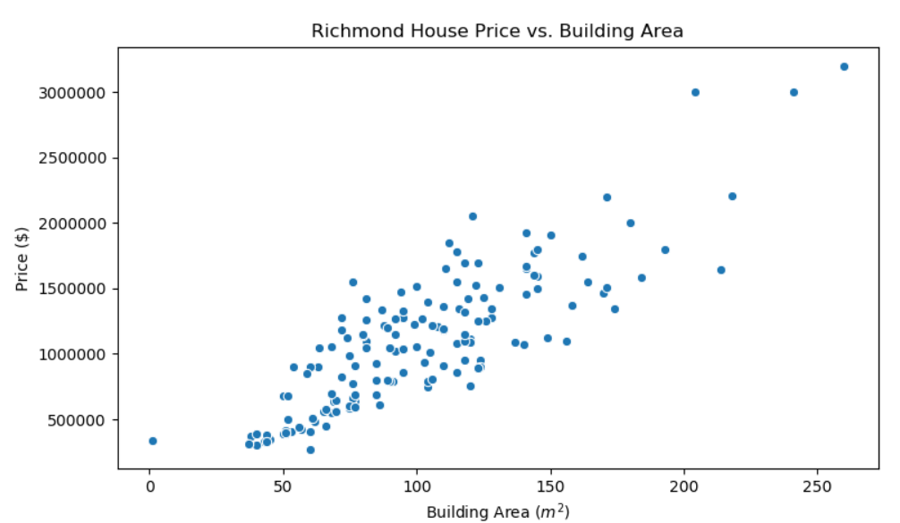
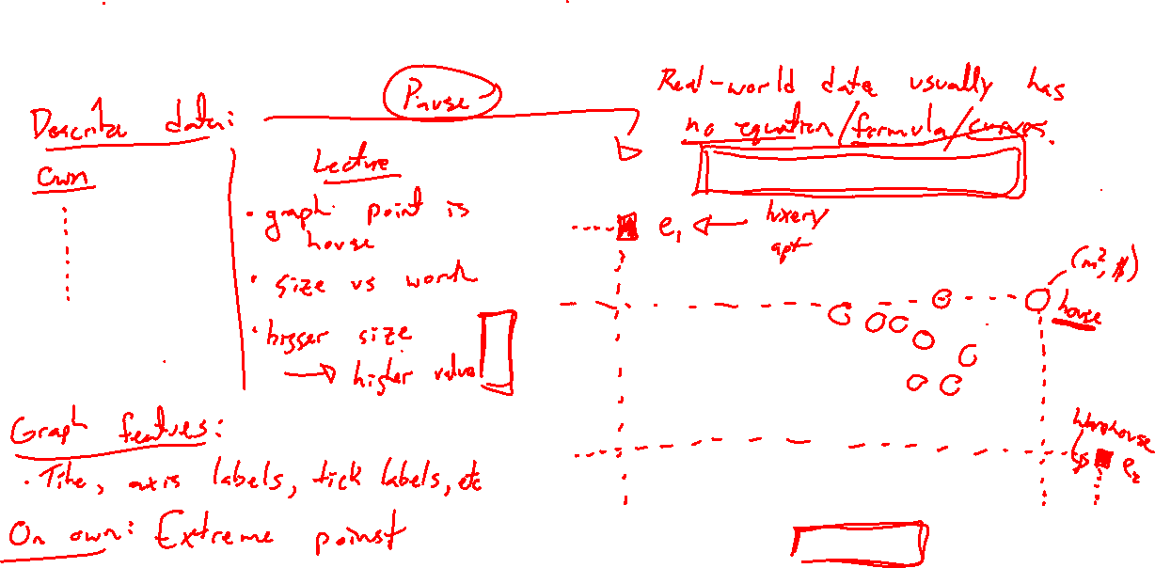
Motivation: Housing Data and Curve Fitting
Notes:
Axis labels super important, axis scales can differ, title super important, can also be misleading
Intuition: add extreme dots and interpret
What if reversed x,y axis? Same data new meaning.
Often no equation (general curve) to fit real data

Slide 3
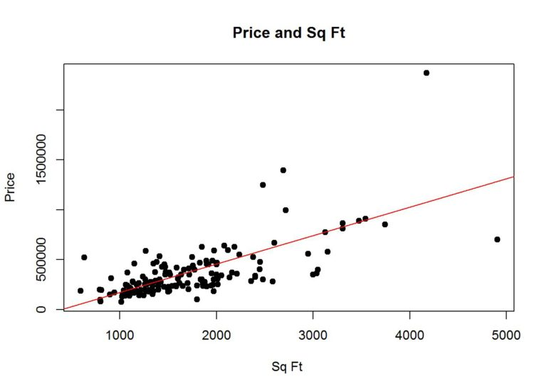
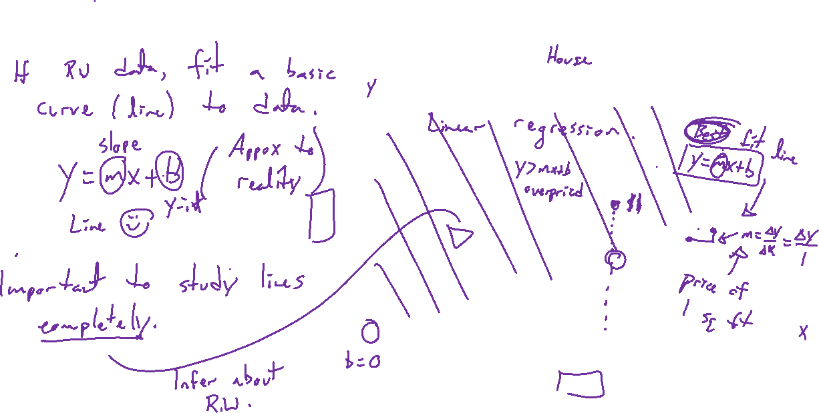
Motivation: Housing Data and Curve Fitting
Notes:
Linear regression: best fit line
How to interpret line? Slope is value of each square foot
What if above line? Below? Distance from line is important.
How to tell if line is any good?

Slide 4
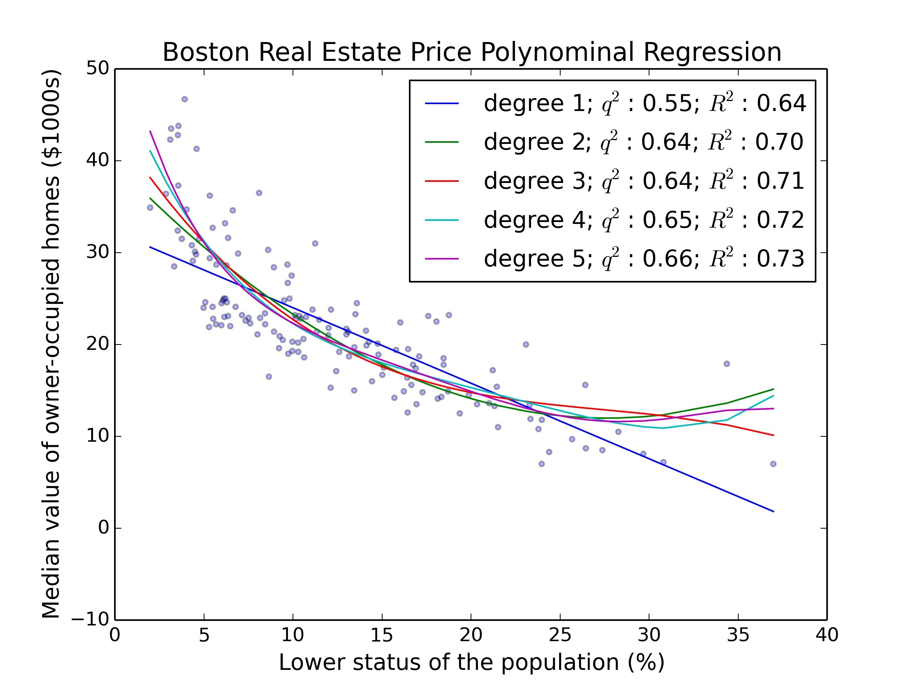
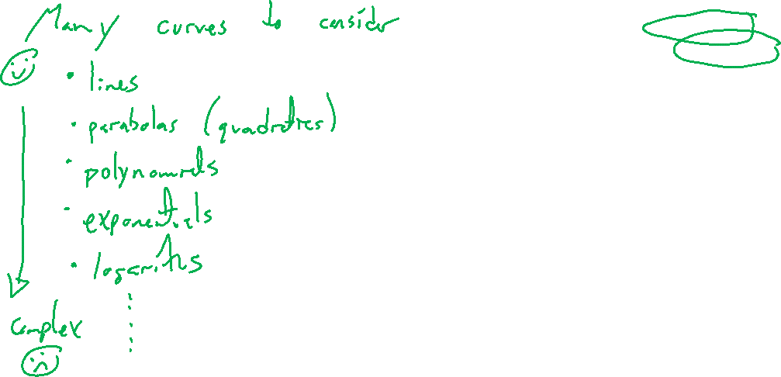
Motivation: Housing Data and Curve Fitting
Notes:
Can use more complex curves (polynomials, others).

Slide 5
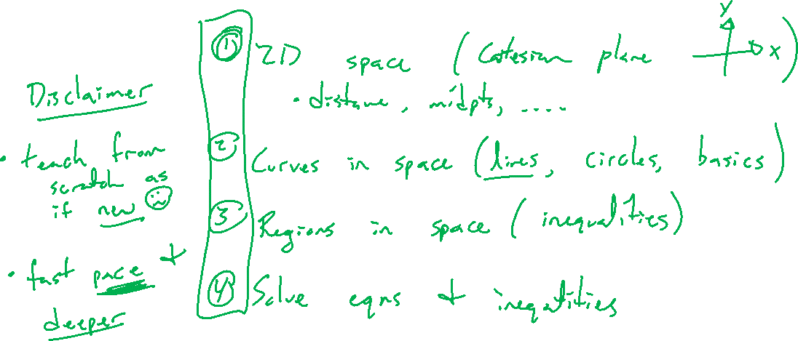
Outline of Chapter
Notes:
Understand 2 dimensional space (cartesian plane, distance)
Curves in 2 space (circles, lines, basics)
Regions in 2 space (inequalities)
Solving equations and inequalities compared to graphs.

